Slide 1
CIS 3200 Term Presentation
Christopher Valdepena
Jiancong Zhang
My Truong
Ryan Applegate
Notes:
Youtube link: https://youtu.be/ff_M_RQtD5E

Slide 2
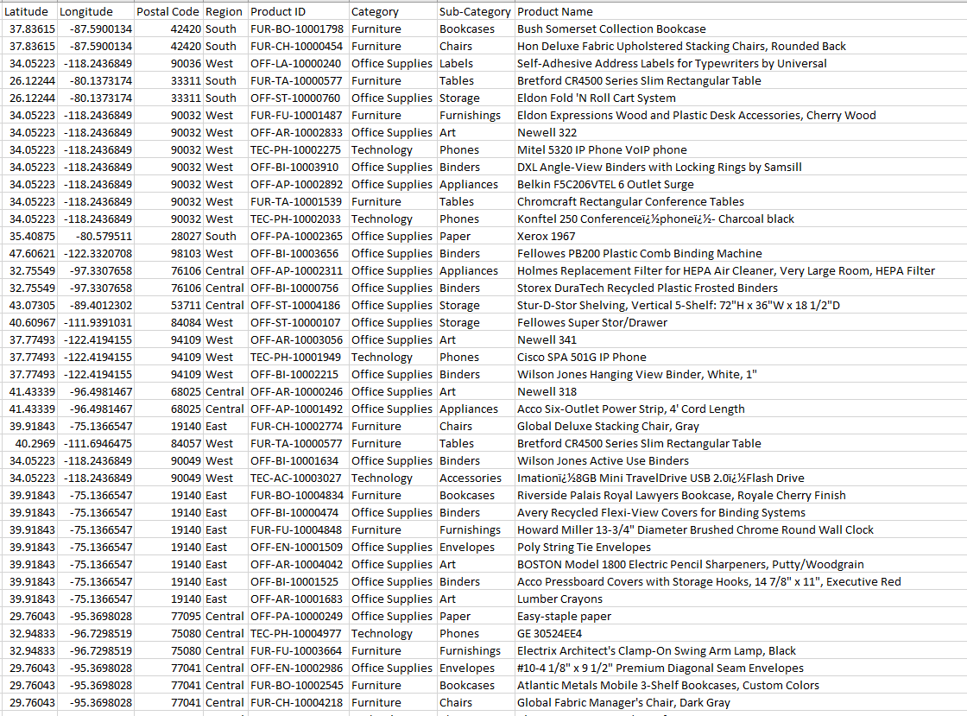
Brief Summary of Our Dataset
<Maybe a snapshot of the data in excel?>
24 columns/dimensions
9,995 records
~ 3MB
<shorturl.at/dnHIW>(Data)
*Snapshot of dataset
Notes:
-Explain original data source & where to find Github repository
- How we plan to utilize the data and what our expectations are (potential insights, visualizations...etc)

Slide 3
Retail Superstore
Summary:
A retail super store has been in operation for the past 4 years while collecting consumer and sales data
Data is managed on-site with no data analytic tool implementation

Slide 4
Retail Superstore
Significance
Larger companies and organizations are leveraging their data, staying leaps ahead of private business owners
We want our analysis to apply to a real-world issue.

Slide 5
Retail Superstore
Our group has been contracted by the company to produce an analytical dashboard
The overall business objective focuses on developing and producing a business process for the retail superstore to maintain future analytics

Slide 6
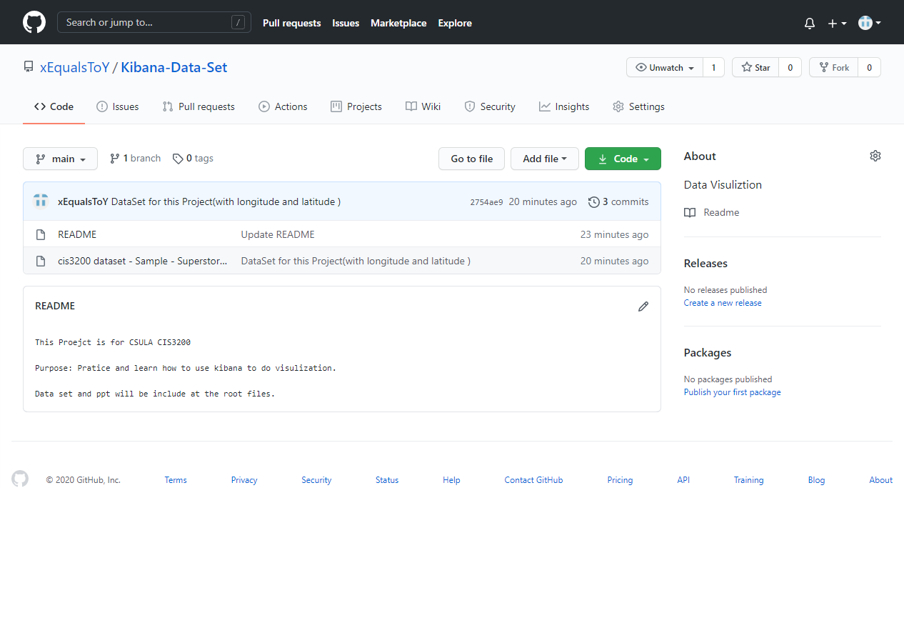
Where is Our Dataset & what is in our Github
24 columns/dimensions
9,995 records
~ 3MB
<shorturl.at/ilpAO>(GitHub)
*Snapshot of Github Repository
Notes:
Where Do we find the data set, and what else is there
what are we going to do with the data

Slide 7
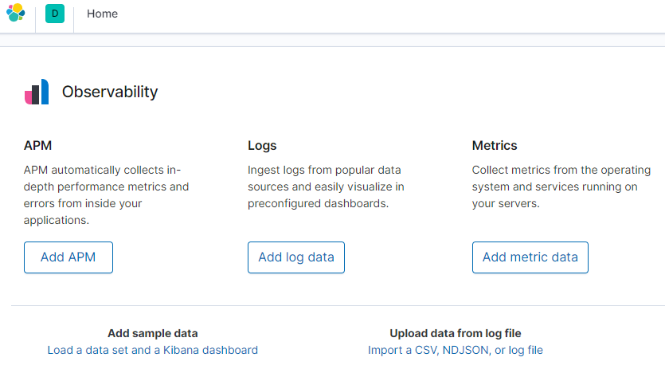
Data Set
Upload the data by using the Import function from kibana’s home page
Notes:
I will continue to present about importing our dataset into ES by using the Import function from Kibana’s home page as you can see on the slide.
However, first we need to transfer the excel file into CSV file, and also use Excel function to add Longitude and Latitude
Then, @ Kibana’s home page, to upload the data, right click on “Import a CSV, NDJSON, or log file”
Then, it will take you to another step where it says “Select or drag and drop a file” -> Click on that
-> NEXT SLIDE

Slide 8
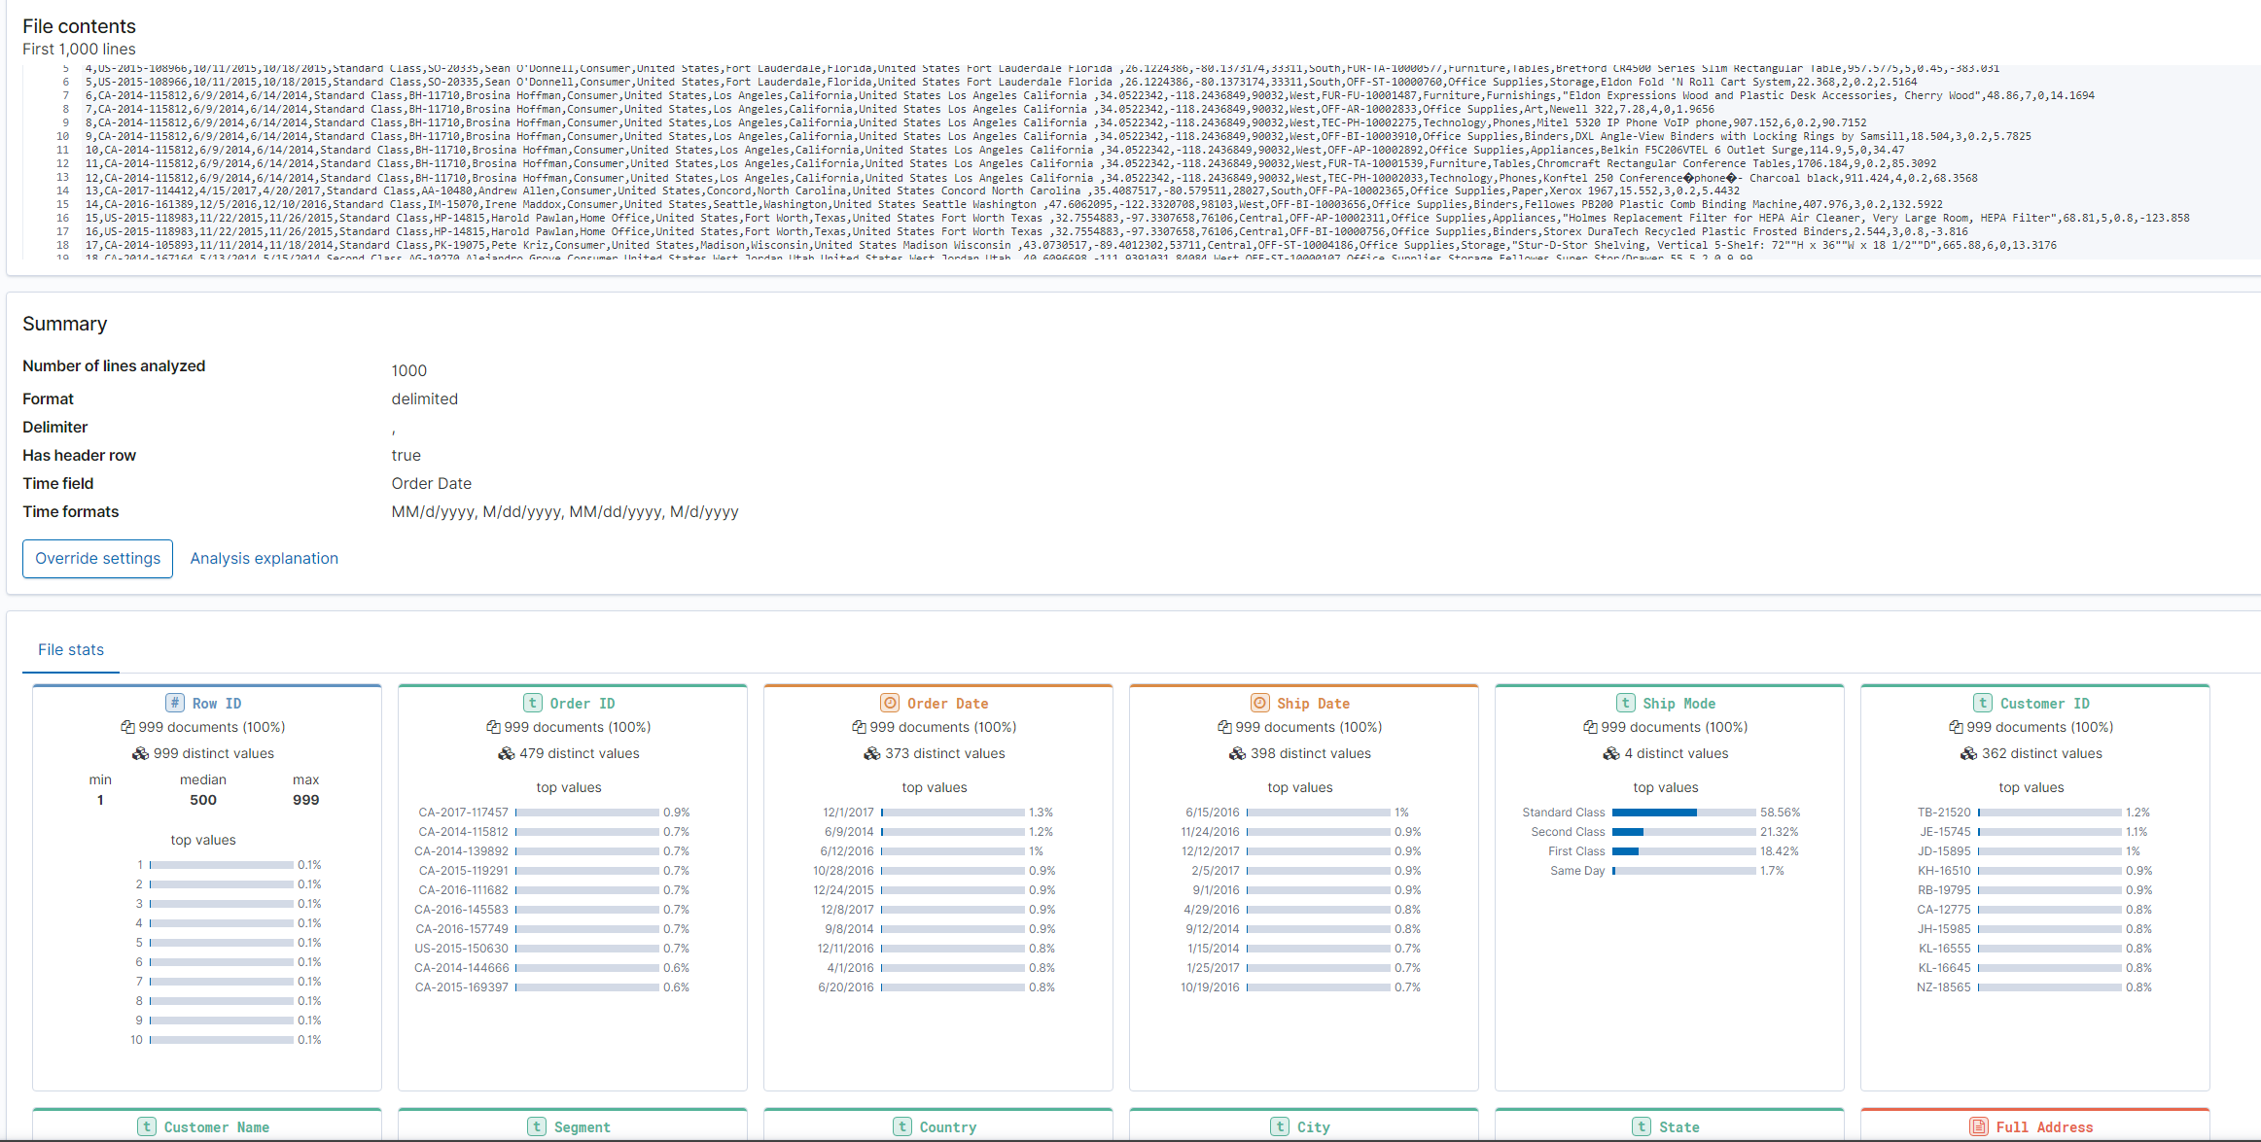
Elasticsearch
Notes:
So, for our group, after we drag our sample dataset into the Importer, called “Superstore”, which will show the data as appeared on the slide.
You can see the file contents of 1,000 lines with Row ID, Order ID, Order Date, Ship Date, Customer ID, and so on.
Next, select “Advanced” to: Add a name for Index name and Unchecked “Create index pattern”
-> NEXT SLIDE

Slide 9
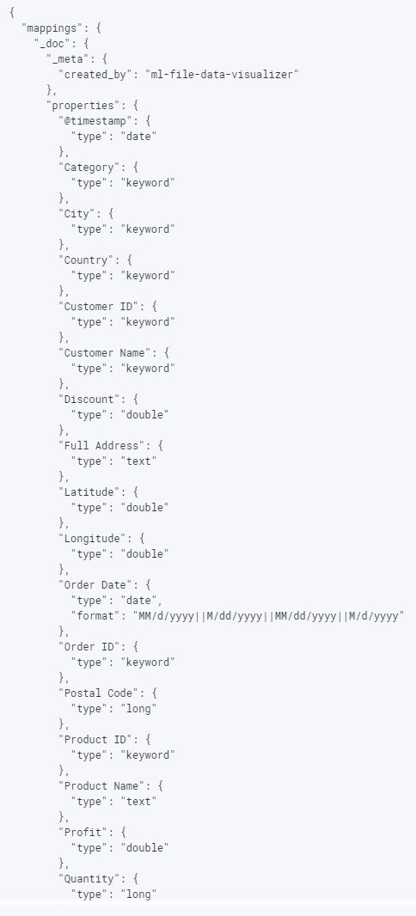
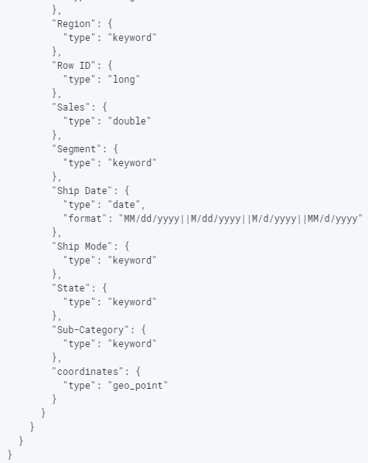
Elasticsearch
Longitude & Latitude dimensions were added prior to import
},
"coordinates": {
"type": "geo_point"
}
Notes:
In the Mapping frame, add the coordinates elements for geo-point for Longitude and Latitude as you can see on the slide.
Then, select Import Data, if there is no error -> so that means the import complete
Last step is to create an Index Pattern by clicking on “Index Pattern Management” and select “Create Index Pattern”
and for “Time Filter field name”, we picked - Order Date
After finished creating the Index Pattern -> We continue to the next step for creating Visualization.
And, Chris will handle this part

Slide 10
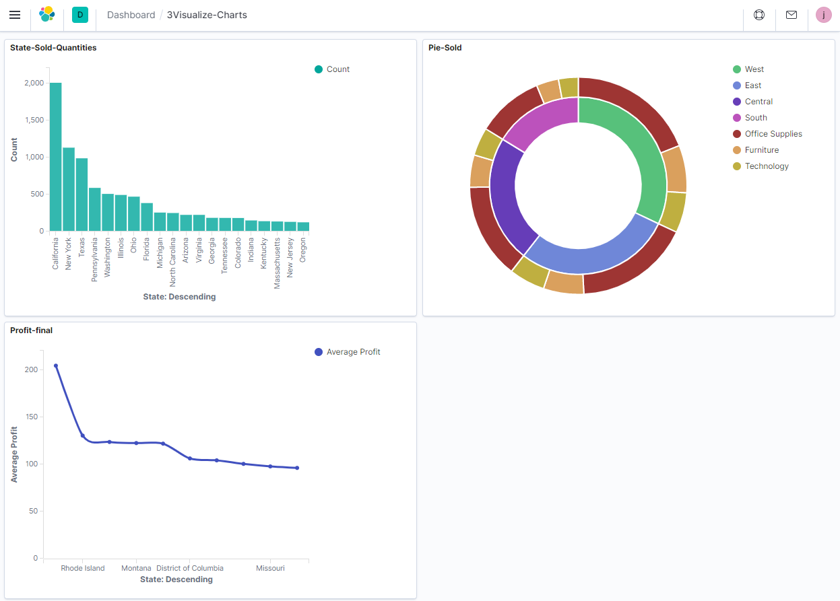
Elasticsearch
Profits and sales vizualized in various graphs.
Each graph has its own properties and categorization.
Notes:
Here we have 3 graphs outlined which which we will go over in more detail in the following slides, but basically, each graph visualizes the profits and sales by region or state from previous dates using a timestamp. By using these graphs we can analyze data quick and then utilize our resources to concentrate in areas that need more improvement and try to increase our results in the future.

Slide 11
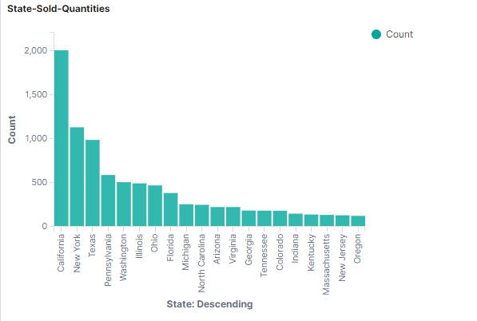
Elasticsearch
What’s your 1st opinion?
This graph visualizes the amount of sold products in various states in descending order.
Notes:
So first, we have the vertical graph which visualizes the amount of sold quantities in different states categorized in descending order. with california being the highest in sold quantities with a count of 2000 and oregon being the lowest in sold quantities with a count less than 500. using this graph we can see that from washington to oregon there is a count less than 500, therefore we concentrate our resources or tools in those areas to further increase our sold quantities.

Slide 12
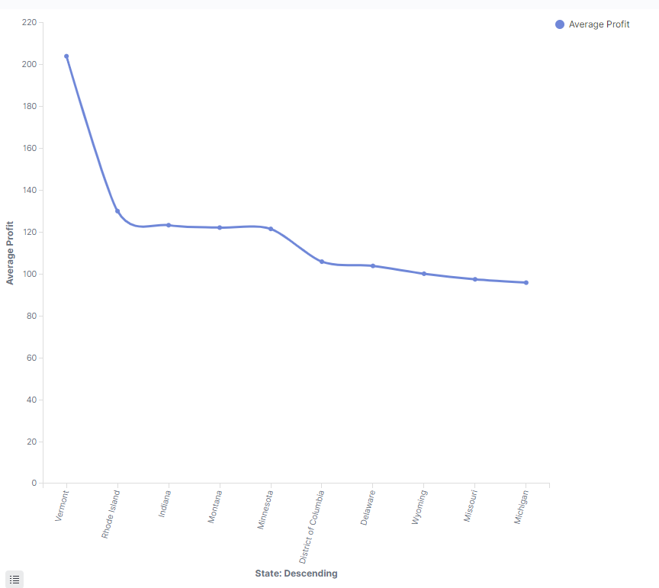
Elasticsearch
something may unexpect
This graph visualizes the average profits earned at various states in descending order.
Notes:
Next, we have a linear graph which visualizes the average profits earned in various states categorized in descending order. As you can see, Vermont stands as the highest average profit earner reaching about 200 and Michigan standing as the lowest average profit earner with about 100 . Using this graph we can estimate our profits in many different areas and concentrate in locations that are in need of improvement.

Slide 13
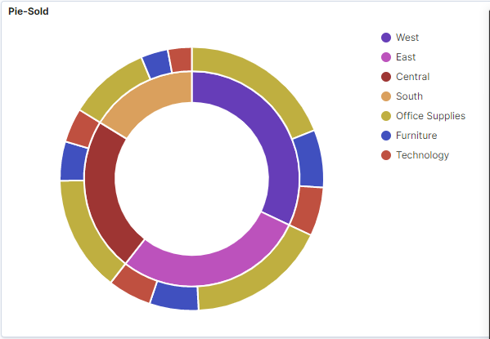
Elasticsearch
Deeper insights
This graph visualizes the amount of sold office supplies, furniture, and technology in different regions.
Notes:
Finally, we have the pie chart graph which visualizes the amount of sold office supplies, furniture, and technology in different regions. As you can see, the west region fills up a good percentage of the pie chart while the south region fills up a small percentage of the pie chart, therefore we can say that the west region is succeeding more than any other region when it comes to selling office supplies, furniture, and technology. Not only that, we can also use this pie chart to evaluate the success of a product in different regions. which in the end, can help us improve our results.

Slide 14
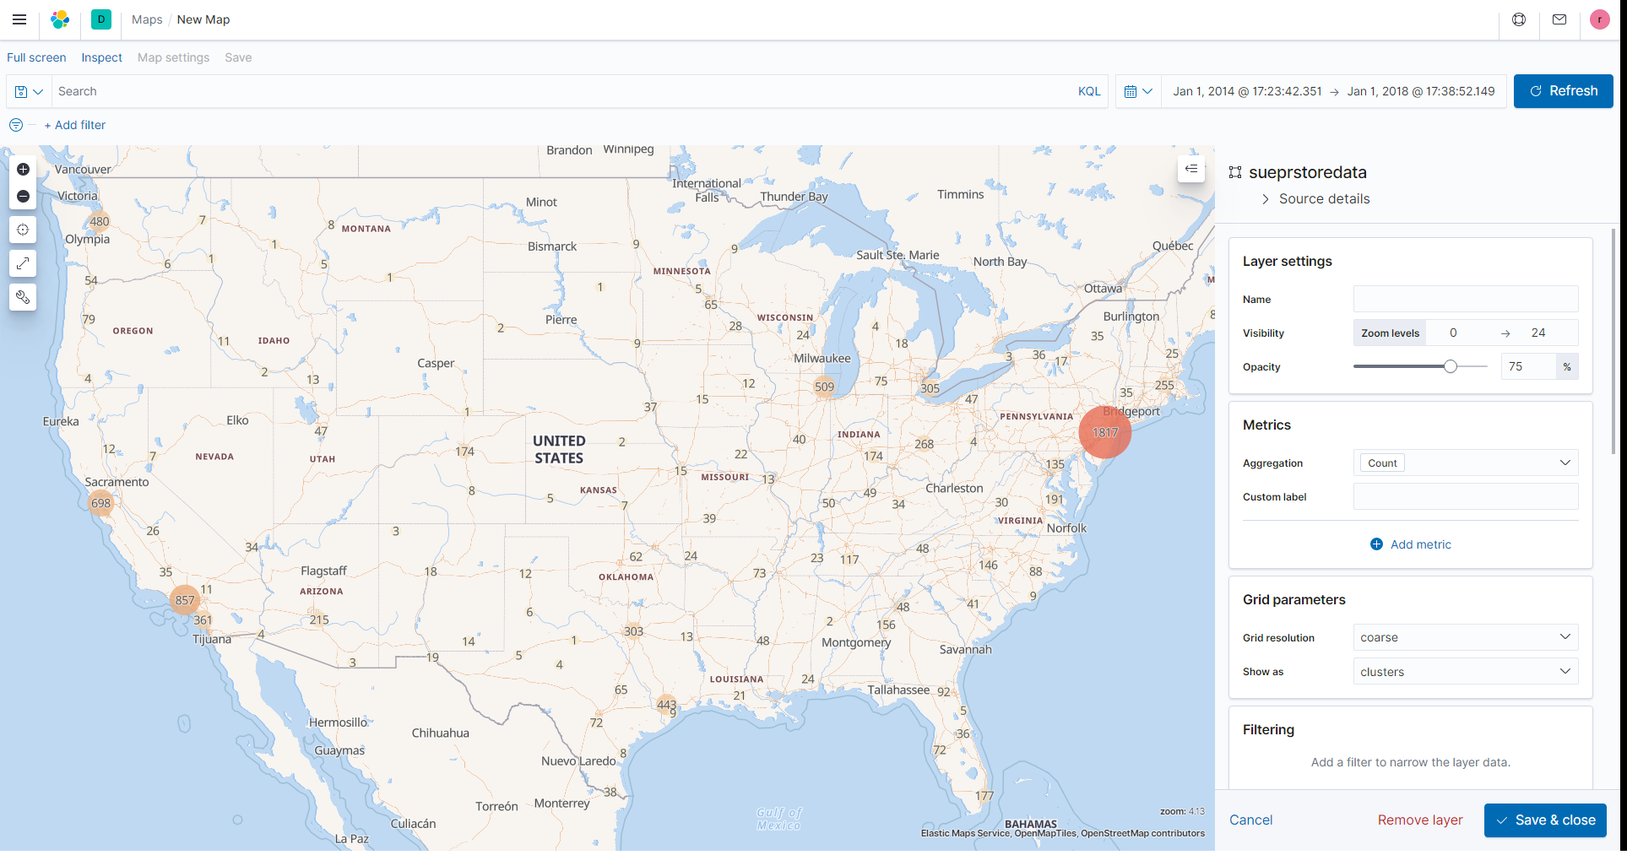
Elasticsearch-
Kibana
Tempo-Spatial Map
Broad overview of total sales subsets
Location of major markets
Notes:
<Notes for whomever covers this slide>
Full view of all sale counts for the past 4 years of operation
Can see where marketing campaigns should be focused
Helps narrow down where we want drill downs for further analysis

Slide 15
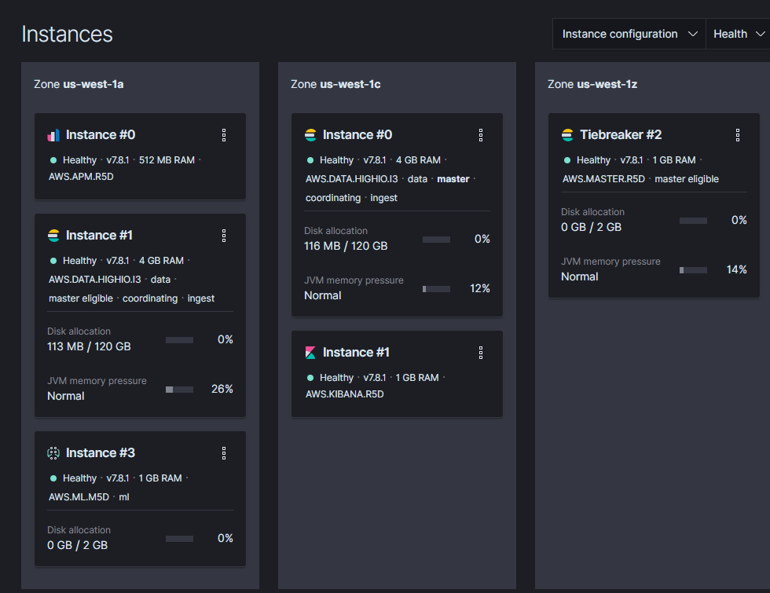
Elasticsearch

Slide 16

Conclusion&Future
Data visualization tools provide us with new methods that can significantly improve our ability to grasp the information hidden in the data
Notes:
It is easier to absorb and grasp information through vision and images than text and numbers. Nonetheless, most business intelligence reports prepared for senior managers are usually filled with static tables and graphs that cannot provide vivid information to those viewing it. In contrast, data visualization enables users to receive large amounts of information about operating and business conditions. Data visualization allows decision makers to view the connections between cubes and provide new ways of interpreting data through the use of heat maps, geographic maps, and other rich graphical representations.
today, the data that companies can collect about customers and market conditions can provide business leaders with insights into new revenue and business opportunities-they can discover opportunities from a large amount of data. Using data visualization, decision makers can more quickly grasp changes in customer behavior and market conditions across multiple data sets.

Slide 17

Group 2.
Thank you!
Q&A Time.

